Slide 1
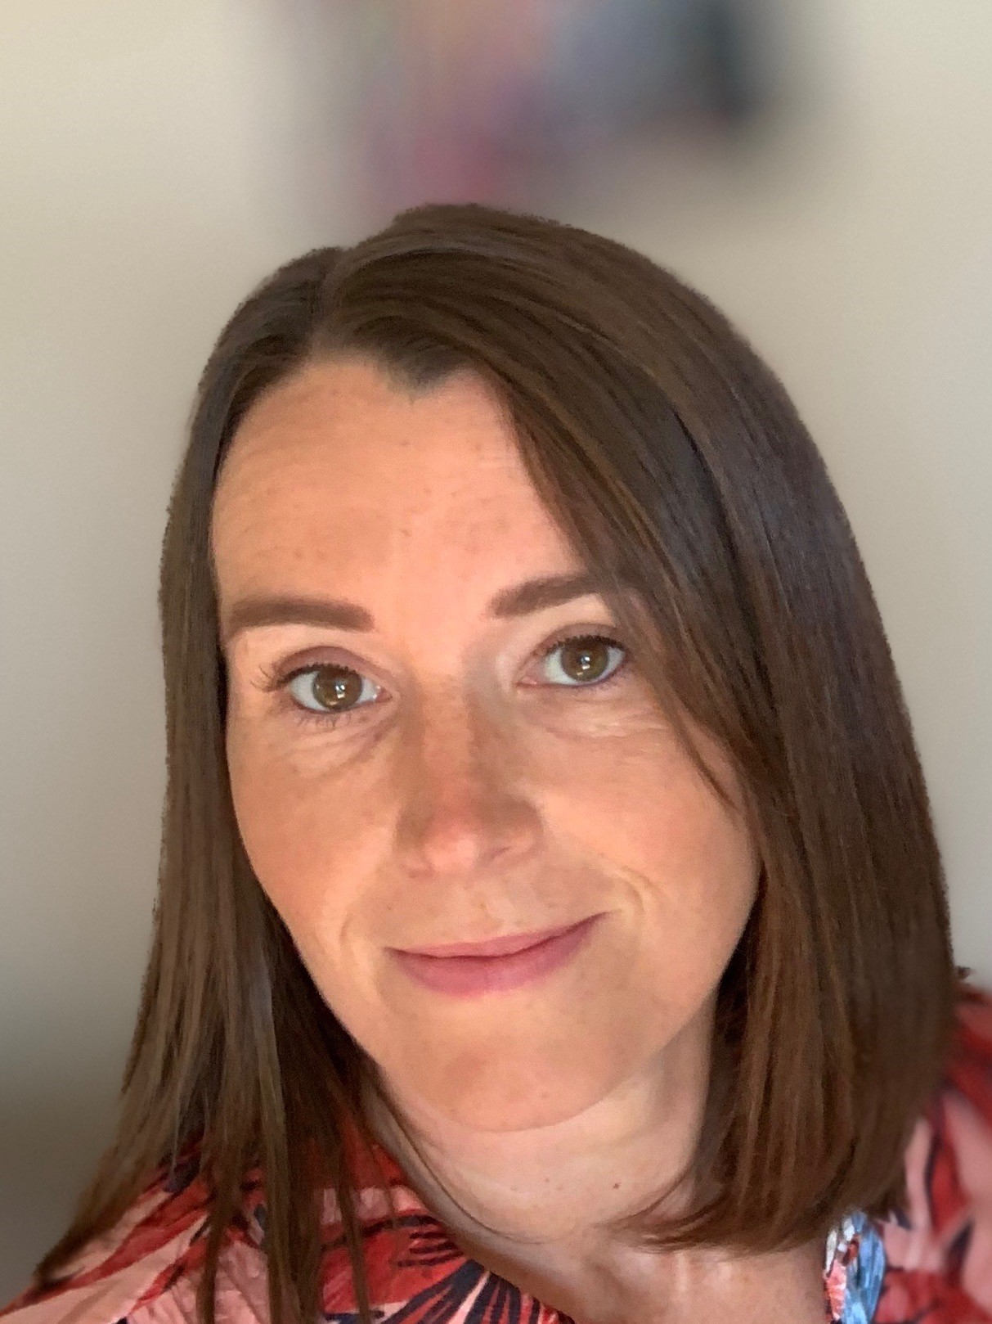
Sara Latto
Career Highlights
Teaching Assistant (2015-2019) St Joseph’s Middle School / St Marys First School, Hexham, UK
Healthcare Assistant (2015) National Healthcare Service (NHS)
Support Services Administrator / Witness Liaison-(2009-20 Northumbria Police, Newcastle-Upon-Tyne, UK
Yeovil Foyer Administrator –(2005-2008) Knightstone Housing Association, Yeovil, UK
Assistant Assurance Officer (2003-2005) HN Revenue and Customs
Additional Experience:
Roles including Supervising Steward (HMS Heron), Dental Nurse, Care Assistant.
Core Skills:
Planning and organization
Excellent people & verbal skills
Excellent in written communications (English native)
Team support and stakeholder management
Emotional intelligence, dedication and supportive.
“I am a highly motivated team player, and I pride myself in my adaptability and resourcefulness. I am dedicated, reliable and thrive on finding solutions to challenges”.

Slide 2
Professional History
Career Highlight: Teaching Assistant St Joseph’s Middle School / St Marys First School, UK
Demonstrating patience and understanding working with small group of students to deliver lessons
Providing clear and concise assistance and 1:1 support for children with complex medical needs, ensuring their safety and effective access to learning activities.
Assessing students’ needs and requirements, in particular disadvantaged pupils & monitoring progress
Development and implementation of Individual Education/Behaviour Plans and Personal Care programmes.
Delivering clerical / administrative support e.g. Updating pupil records, photocopying, typing, filing, money, administer coursework, reception desk cover etc.
Tracking student data and recording accurately within the school systems to meet reporting requirements
Read with individual children and groups and complete reading records as directed by the class teacher.
Stakeholder management liaising with teaching staff, administration team, parents and social services to act on any issues as they occurred.

Slide 3
Professional History
Career Highlight: Support Services Administrator / Witness Liaison- Northumbria Police, Newcastle-Upon-Tyne, UK
Primary liaison for court witnesses to Police and Crown Prosecution Service
Issuing and coordinating witness correspondence (phone, letter, and email), ensuring that they understand what is required of them prior to and during court appearances
Liaise with police, forensics, crown and magistrates court, probation, victim support and many other internal external agencies and resolving any issues in a timely manner
Supporting witnesses by facilitating the necessary support services such as victim support as well as talking them through any concerns / problems they may have
Proficiency across using various IT systems including updating both hard copy and electronic confidential records in multiple databases used by Police and Crown Prosecution Service
Providing support and understanding to facilitate specific measures for vulnerable court witnesses such as video links into the court
Providing weekly update reports for the Crown Prosecution Service and working in a flexible, efficient manner
Arrange travel and accommodation for court witnesses as required keeping to cost and time constraints

Slide 4

Continuing Education
Cache level 1 award in Safeguarding in a Learning Environment
NVQ2 Advice and Guidance
Foundation Certificate in Health & Safety in The Workplace
Child Protection – SITRA In-House Training
European Computer Drivers Licence
Scottish Higher English, Geography
Core Mathematics 3 Module
Scottish Standard Grade English, Art, History, Home Economics, Modern Studies, Mathematics, Chemistry
ICT / SOFTWARE PROFICIENCIES
Microsoft Word, Microsoft Excel, Outlook, various database, and management platforms.
Currently enrolled in developing digital skills for Microsoft Office training.
Volunteering & interests
Volunteer work with schools, and community groups in Holland
Learning Dutch
Career Highlights
A key career highlight for me has been experience working in some challenging industries (Customs, police, special needs education) and being able to make a difference to the individuals and teams that I’ve had the opportunity to work with along the way”.
Sara Latto
Spoorzichtlaan 1, 2106AV, Heemstede, North Holland
Mobile: 0615444217 Email: lattosara@aol.com

